Slide 1
COMMUNITY-BASED INTERVENTIONS TO REACH 95-95-95 FOR CHILDREN AND ADOLESCENTS: AN EXPLORATORY PROGRAMMATIC REVIEW FROM LESOTHO
Anouk Amzel MD, MPH on behalf of co-authors
Meena Srivastava DO, MPH; Anthony Isavwa, MSPH; Jill Sanders, MD; Esther Tumbare MD, DMH, MPH; Ian Membe MPH; Justine Mirembe MD; Seema Ntjabane BNSc; Peter Raliile BA; Matsitso Mohoanyane BA; Victoria Ryan, MSPH
July 25, 2018

Slide 2
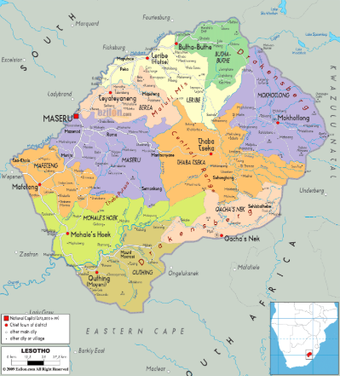
LESOTHO BACKGROUND
Overall population 2,263,010¹
1,009,495 under 24²
2.1% prevalence in <14
21,950 CLHIV and ALHIV (ages 0-24 years), with 13,935 on ART³
¹ http://www.worldometers.info/world-population/lesotho-population/
^{2:} https://www.indexmundi.com/lesotho/demographics_profile.html
³ https://phia.icap.columbia.edu/countries/lesotho/
Notes:
coping with life changes; dealing with normal childhood and adolescent developmental adjustments; and managing the transition from adolescence to adulthood

Slide 3
ADHERENCE & RETENTION SERVICES IN LESOTHO

Slide 4
METHODS
Data: Program-level retrospective chart data
Population: ages 5 to 24 years
Timeframe:
September 2017 data as part of routine annual results reporting to PEPFAR
October 1, 2016 and ending September 30, 2017
Definitions:
Twelve-month retention and viral suppression defined per PEPFAR Monitoring, Evaluation, and Reporting (MER) guidance
Proxy viral coverage was ratio between PLHIV with a viral load in their chart and number of PLHIV on ART
Review was conducted based on:
District-level 12-month retention and viral suppression data (implementation districts only).
Comparison of hospital-level 12-month retention and viral suppression data from implementation districts and non-implementation districts
Notes:
retrospective review of 12-month retention, proxy viral load coverage and viral suppression data from all facilities in the three implementation districts of Maseru, Mafeteng, and Mohale’s Hoek. Data from one facility located in Mohale’s Hoek was excluded due to lack of available 5-year age disaggregations.
For the second analysis, the authors collected 12-month retention, proxy viral load coverage and viral suppression data from select sites in the three non-implementation districts —Thaba-Tseka, Butha Buthe, and Mokhotlong—to compare to the implementation district dataset from the first analysis.

Slide 5
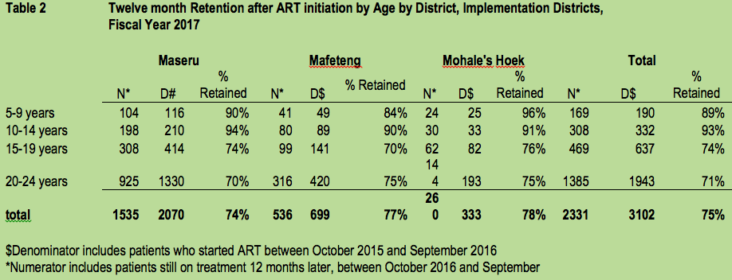
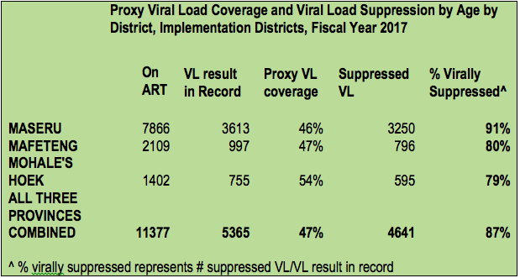
RESULTS: Implementation Districts
3,102 patients newly initiated
12-month retention = 75%
11,377 patients on ART
5,365 (47%) had a viral load documented
4,641 (87%) had a suppressed viral load.

Slide 6
RETENTION RESULTS: Implementation vs. Non-Implementation District Hospitals
490 patients newly initiated on ART, with 346 (71%) implementation-district and 144 (29%) from non-implementation-district
353 (73%) and 90 (63%) respectively were still retained in care at 12 months.

Slide 7
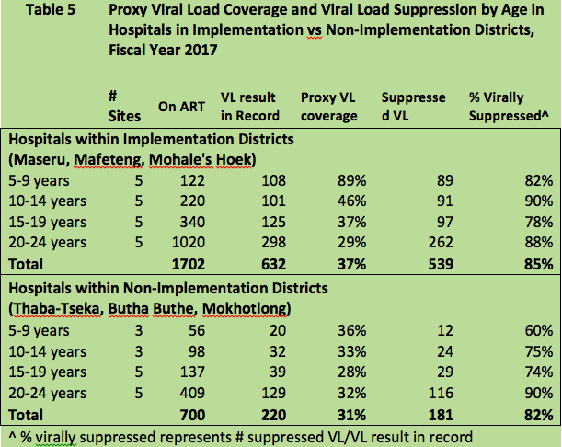
VIRAL LOAD RESULTS: Implementation vs. Non-Implementation District Hospitals
2,403 patients on ART
1,702 patients from implementation district hospitals
632 (37%) having recorded viral load result
539 (85%) virally suppressed
700 patients on ART from non-implementation district hospitals
220 (31%) having documented viral load result
181 (82%) virally suppressed.

Slide 8
CONCLUSIONS
1. Implementation districts
Retention rates in the implementation districts is reasonable, but can be improved
Viral load coverage is low, but suppression rates are high
2. Implementation vs non-implementation districts comparison
Significantly better retention in implementation district hospitals compared to non-implementation district hospitals
10-14 year olds
Low viral load coverage in both types of district hospitals
Of those tested, high levels of viral suppression

Slide 9
KEA LEBOHA

